Slide 1
Collaboration 👯‍♂️
CSCI 3002 Fall 2018

Slide 2
Today
Thinking beyond the individual
Designing systems to support collaborative interaction

Slide 3
Topics in this area
Online communities (what makes them successful?)
Social computing
CSCW (Computer Supported Cooperative Work)
Combine computer science, HCI, social science

Slide 4

Discussion
Talk to your neighbor for 4 minutes
Describe an online community that you've participated in
Why did it work or not work?

Slide 5
Why online communities work

Slide 6
Why online communities work
+ Lang-8. Status, matchmaking.
- Ello. Critical mass.
+ StackOverflow. Community moderation.
+ MyFitnessPal. Sharing of exercise, fitness

Slide 7
Successful strategies
Make sign up and use easy
Admin/moderation (removing junk content; harassment)
Support social interaction (e.g., welcome committee)

Slide 8
Admin/moderation
Community mods (e.g. Reddit)
Paid mods (e.g. Metafilter; World of Warcraft)

Slide 9
Participation in online communities
1% rule; participation inequality
http://www.nngroup.com/articles/participation-inequality/
How does participation change over time?

Slide 10
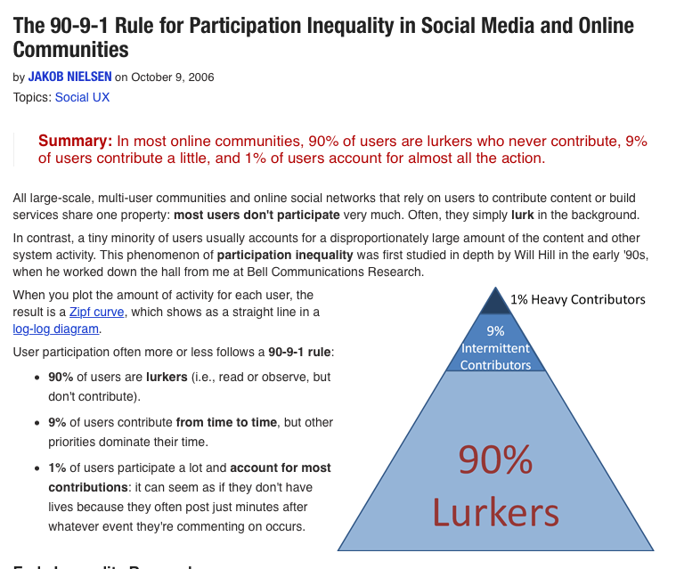

Slide 11
Other topics in online communities
Crowdsourcing
Identity management

Slide 12
Crowdsourcing
Amazon Mechanical Turk (http://mturk.com)
Support microtasks for small amounts of money
Can be plugged into live running code to do things that computers can’t

Slide 13
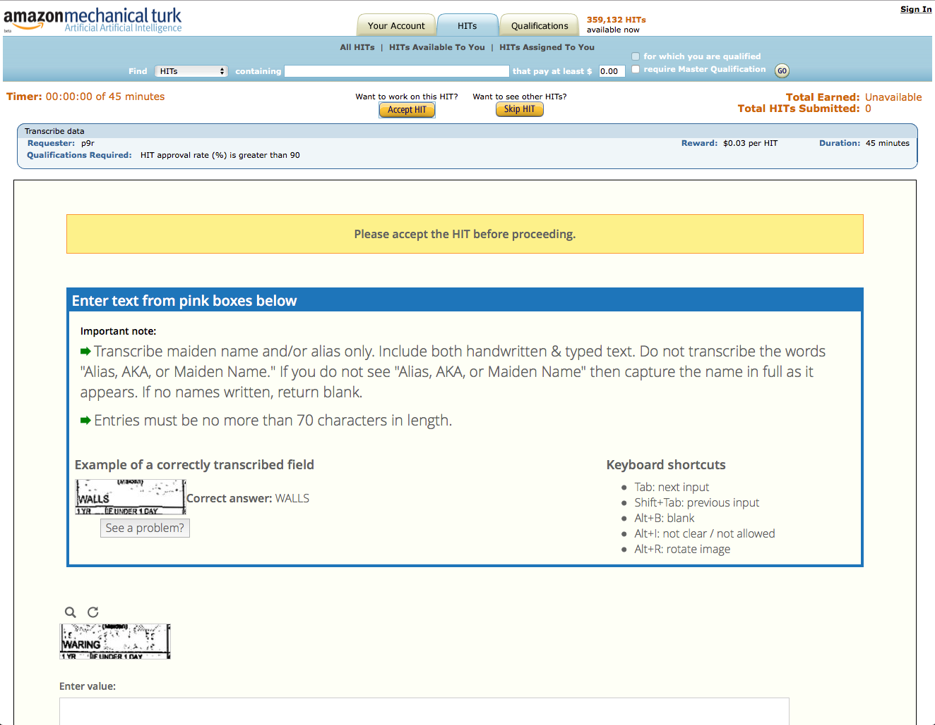
Mechanical Turk

Slide 14
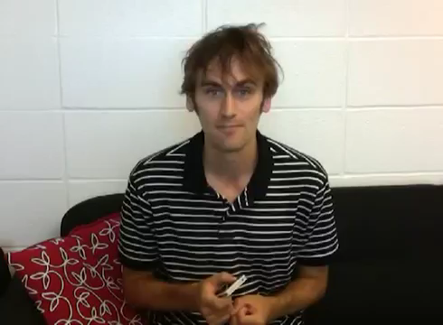
VizWiz
https://www.youtube.com/watch?v=EtfriMJQ0_M

Slide 15
Identity management
Interacting online often forces us to choose how to represent ourselves
Examples
Facebook's real names policy
Representation of gender online
Multiple identity management

Slide 16
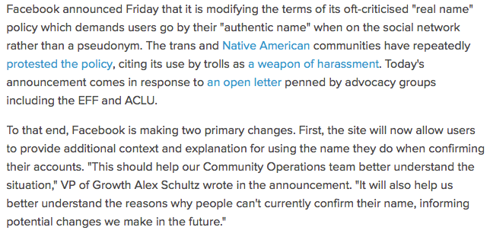
Real names on Facebook
http://www.engadget.com/2015/10/30/facebook-changes-real-name-policy-rules-after-public-outcry/

Slide 17
Representation of gender online
Facebook supports 58 gender identities: Agender, Androgyne, Androgynous, Bigender, Cis, Cisgender, Cis Female, Cis Male, Cis Man, Cis Woman, Cisgender Female, Cisgender Male, Cisgender Man, Cisgender Woman, Female to Male, FTM, Gender Fluid, Gender Nonconforming, Gender Questioning, Gender Variant, Genderqueer, Intersex, Male to Female, MTF, Neither, Neutrois, Non-binary, Other, Pangender, Trans, Trans*, Trans Female, Trans* Female, Trans Male, Trans* Male, Trans Man, Trans* Man, Trans Person, Trans* Person, Trans Woman, Trans* Woman, Transfeminine, Transgender, Transgender Female, Transgender Male, Transgender Man, Transgender Person, Transgender Woman, Transmasculine, Transsexual, Transsexual Female, Transsexual Male, Transsexual Man, Transsexual Person, Transsexual Woman, Two-Spirit

Slide 18
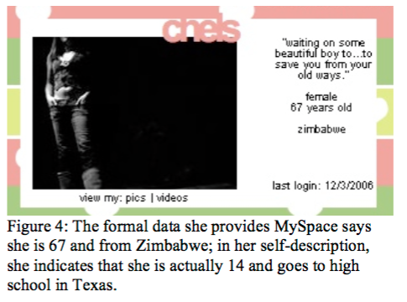
Multiple identity management
danah boyd (2007). "Why Youth (Heart) Social Network Sites: The Role of Networked Publics in Teenage Social Life." MacArthur Foundation Series on Digital Learning - Youth, Identity, and Digital Media Volume (ed. David Buckingham). Cambridge, MA: MIT Press, pp. 119-142.

Slide 19
Designing collaborative tools

Slide 20
Designing collaborative tools
Computing tools often used in a group
Need to support usability for each user, but also support efficient collaboration

Slide 21
Discussion
Talk to your neighbor for 4 minutes
Describe a time you have collaborated on some task with a partner
Why did it work or not work?

Slide 22
Collaborative tools
+ Google Slides. Easy to work remotely.
+ Screen share. Easy to discuss, highlight stuff.
- Google Slides. User interface not suited for prototyping
? WoW. Balance of roles; well defined roles. Show activity.
+ Minecraft. Easy to track.

Slide 23
Types of collaboration
Synchronous vs. asynchronous
Collocated vs. remote
Which devices? (shared device, multiple devices)

Slide 24
Challenges to collaboration
Awareness (what is my partner up to? what did they do?)
Control (who has control?)
Synchronization (how to coordinate simultaneous work, collisions)
Diverse devices or diverse abilities

Slide 25
Awareness
What is my partner doing?
What have they done?

Slide 26
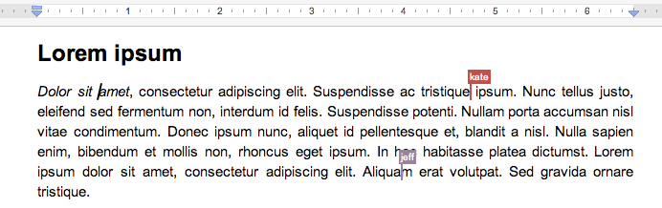
Google Docs (awareness)

Slide 27
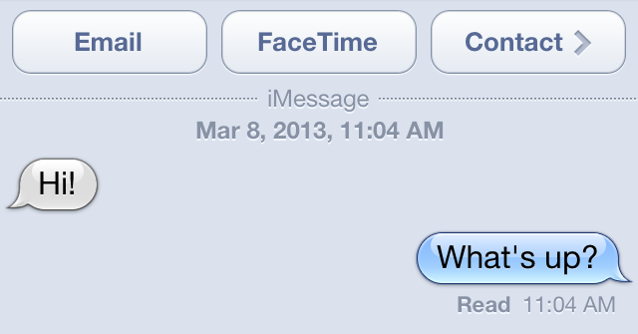
Awareness not always desired

Slide 28
Github (history)

Slide 29
Control
How can we support people working together?
Prevent collisions, accidental overwrites

Slide 30
Control approaches
Lock a document or part of a document
Roles with permissions
Support merge

Slide 31
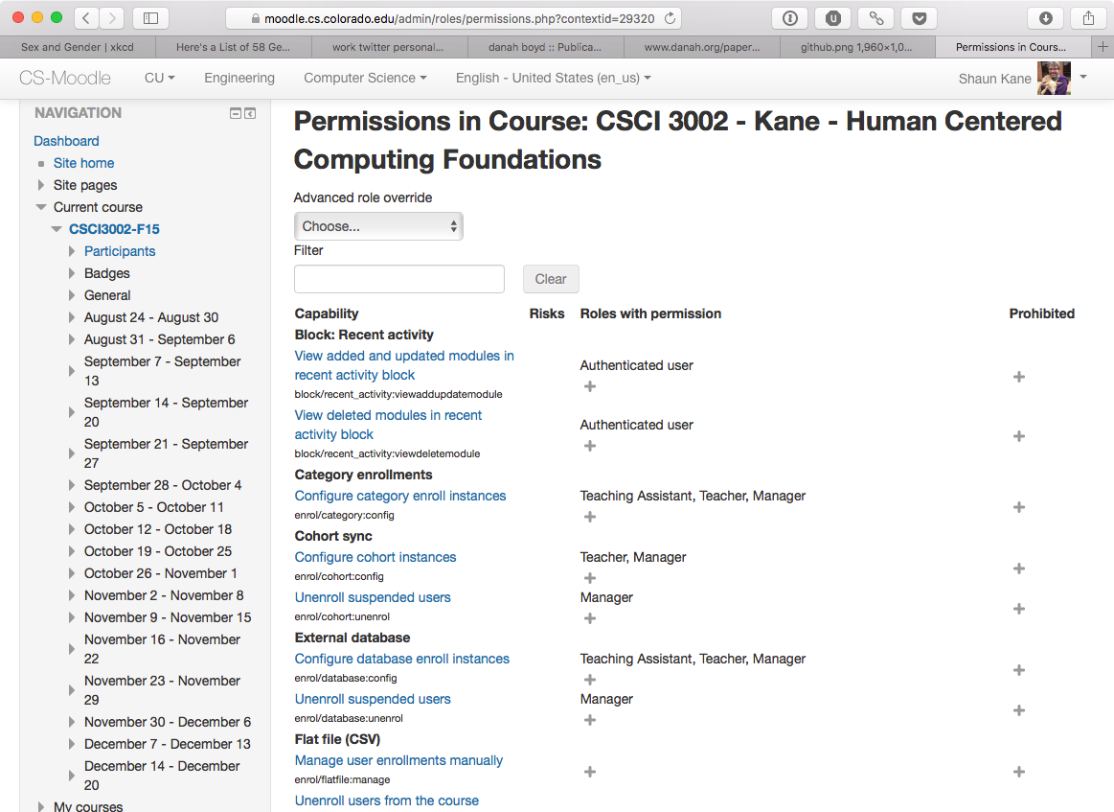
Roles (Moodle)

Slide 32
Synchronization
Control challenges can be exacerbated when people are editing together
Consistency
Cheating (e.g. in games)

Slide 33
Diverse devices
What devices do users have?
Shared device (single display groupware)
Multiple devices (multi-display groupware)
Do devices have the same capabilities?

Slide 34
Cross-ability collaboration
These challenges are exacerbated when people are using very different devices or have different abilities
Due to disability or some other factor such as remote collaboration

Slide 35
Challenges in cross-ability collaboration
Awareness (both in the system and out of the system)
Mutually incompatible interfaces
Cross talk between screen reader and conversation

Slide 36

Beam telepresence robot
https://www.youtube.com/watch?v=P0DzN7oxnX8

Slide 37
Activity
Let's design a system to support grade books
Support a collectivist model: grades are negotiated between students and professor
Sketch out a paper prototype (and turn it in)

Slide 38
Next time
Designing Gestures

